Slide 1
Advanced Branch Prediction in SimpleScalar
Implementing Combinational and Perceptron-Based Predictors
ECE 687/587 Advanced Computer Architecture I
Mohamed Ghonim, Ahliah Nordstrom, Sai Mounisha Gurram, Mahalsa Sai Dontha

Slide 2
Agenda
01
02
03
04
Project Overview
Intro to Branch Prediction
SimpleScalar Simulator Overview
Combinational Two-Level Adaptive Predictor
05
06
07
08
09
Benchmarks
Conclusion
Acknowledgements
Perceptron-Based Predictor
Implementation Challenges

Slide 3
01: Introduction to Branch Prediction
CPU Performance
Pipeline Stalls
Traditional Techniques
SimpleScalar
Reduction of pipeline stalls and increasing instruction throughput to improve overall processing speed and efficiency
Guessing outcome before computation to allow continuous instruction execution
*Evolution from static to dynamic branch prediction
Preeminent implementation currently is single adaptive two-level branch predictor

Slide 4
02: SimpleScalar Simulator Overview
Relevance and Use Cases
Implementation in C
Widely used architectural simulator
Versatile platform for experimenting advanced processor architectures
Modularity and extensibility
Highly complex and comprehensive integration
Weaving in a new BP within the established SimpleScalar
Not as easy as only calling a BP function when needed

Slide 5
03: Project Overview
Motivation
Enhance simulator’s predictive capabilities as much as possible while also contributing to the field of dynamic branch prediction
Combinational Two-Level Adaptive
This obtainable implementation is highly adaptable and designed to enhance accuracy while reducing aliasing and conflict
Perceptron
Notably difficult implementation that would reward us with longer branch histories, complex pattern recognition, and superior performance

Slide 6
04: Combinational Two-Level Adaptive Predictor
Meta-Predictor Integration
Interface & Control Logic
Duel Predictor Architecture
History Length Management
In parallel, requiring expansion of simulators data structures to indicate new PHT and counters
Implemented mechanisms to dynamically manage and update history lengths with the use of algorithms that adjust based on current prediction outcomes and program behavior
Essential for combinational approach as it utilizes saturating counters that correspond to each branch instruction to track/compare accuracy of the two predictors
Simulators interface modified by adding control logic to enable selection and configuration of combinational predictor.

Slide 7
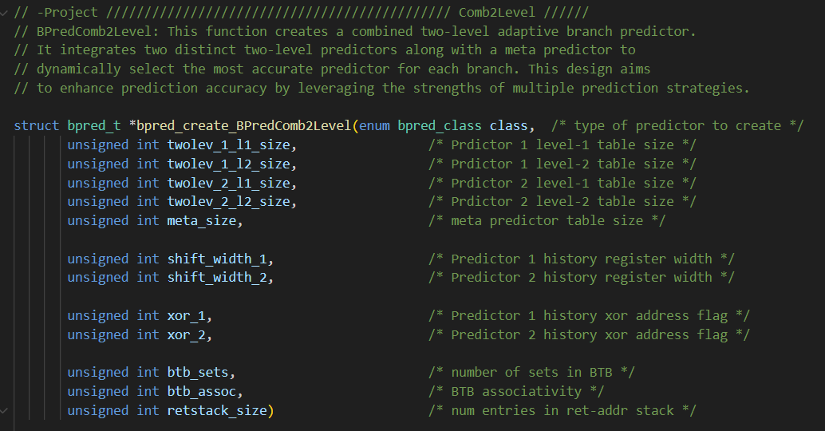
Function Prototype for Creating Two-Level Adaptive Branch Predictor w/ Meta Predictor (bpred.c)

Slide 8
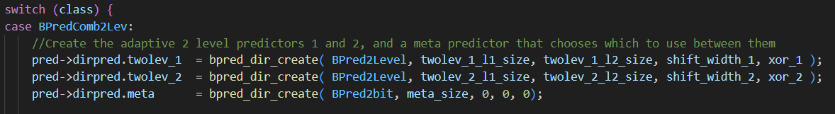
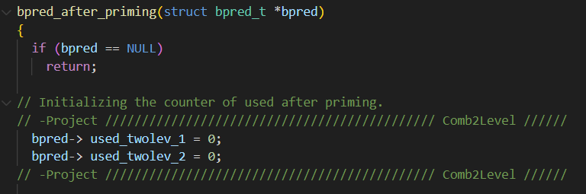
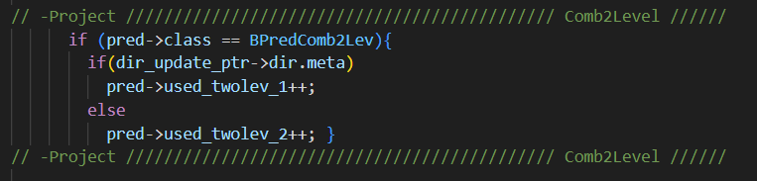
Branch Predictor Initialization (bpred.c)
Function to Reset BP Counters Post-Priming (bpred.c)
BP Update Logic in Combined Predictor (bpred.c)

Slide 9
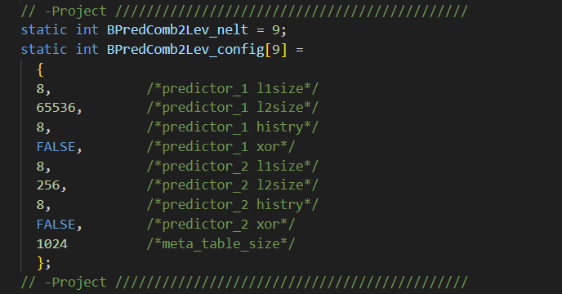
Configuration Array (sim-outorder.c)

Slide 10
05: Perceptron-Based Predictor
Data Structure and Algorithm Integration
Handling Perceptron IO
1
x₁
x_{i}
x_{n}
…
…
Development of efficient data structures to store weights and branch histories.
Takes global branch history as inputs and outputs a prediction. Special attention w/ respect to SimpleScalars data handling conventions.
ω₁
ω_{i}
ω₀
ω_{n}
y
Resource Optimization
Compatibility w/ SimpleScalar Architecture
w0 + ∑ n, i=1, xi wi = 0
Limited potential increase in computational load by integrating w/ existing SimpleScalar BP infrastructure.
Designed for compatibility w/ different configurations of SimpleScalar, helpful to other users and uses.
Once output ‘y’ computed, we train it
If branch NT -> += -1
If branch T -> += 1
Modular Design
Testing & Validation
If sign(y_{out}) ≠ t OR |y_{out}| ≤ 0
THEN for i = 0 to n DO
w_{i} := w_{i} + tx_{i}
Modular component to facilitate easy updates, debugging, and other future expansions.
Unit testing of individual components and integrated testing within the full simulator.

Slide 11
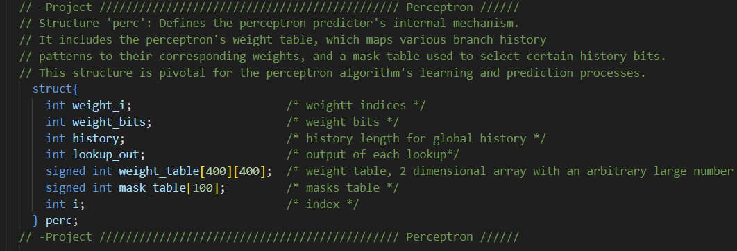
Perceptron Predictor Data Structure Definition (bpred.c)

Slide 12
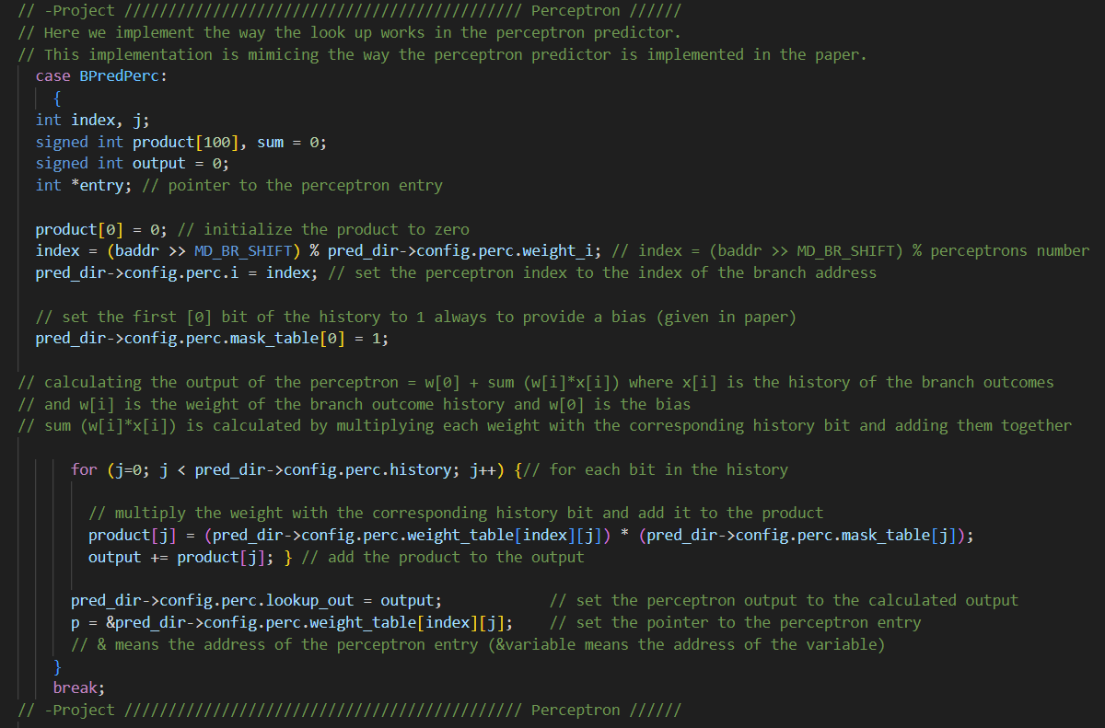
Perceptron Lookup in BP (bpred.c)

Slide 13
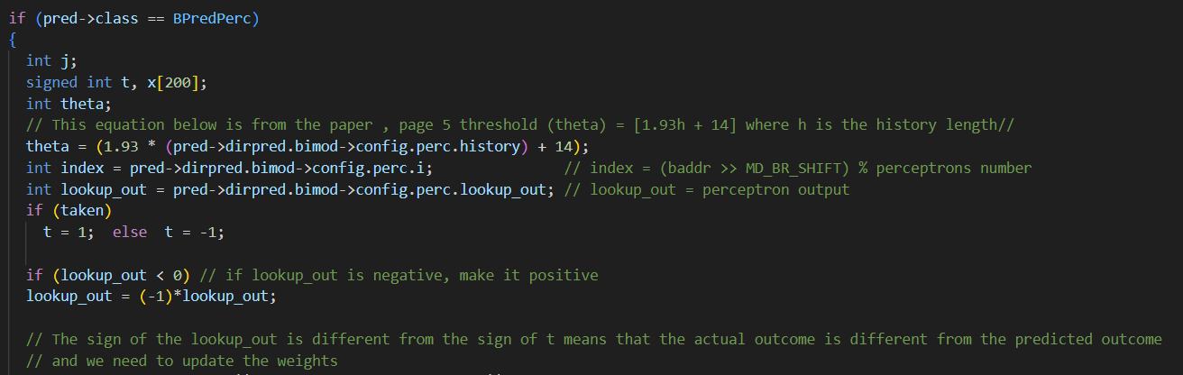
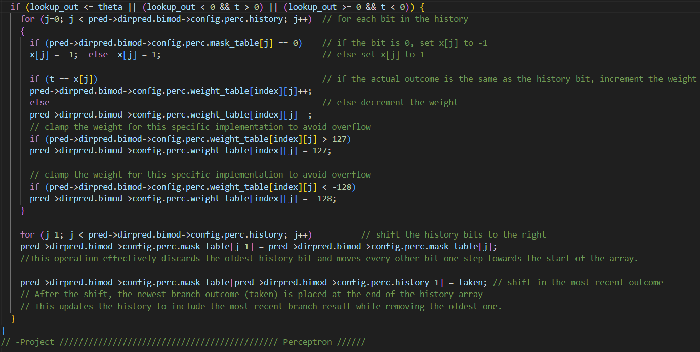
Perceptron BP Weight Update (bpred.c)
This section updates weights of the perceptron-based branch predictor. It's executed after the actual branch direction is resolved.
Steps:
1. Calculate threshold (theta) for weight updating using formula from referenced paper.
2. Determine actual branch outcome (t) as 1 (taken) or -1 (not taken).
3. Adjust perceptron output (lookup_out) to always be positive for comparison.
4. Check if weights need to be updated based on the perceptron output and actual outcome.
5. Update weights based on history and actual outcome. Increment or decrement weights depending on the match with actual outcome. Clamp weights within the range [-128, 127] to avoid overflow.
6. Update the history of branch outcomes, shifting in the most recent outcome.

Slide 14
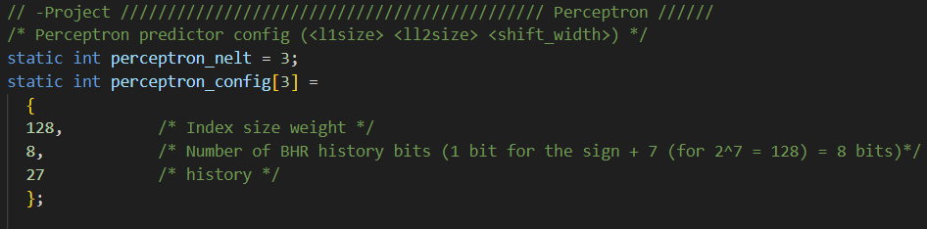
Configuration Array (sim-outorder.c)

Slide 15
06: Implementation Challenges
 | PREDICTOR | CHALLENGE | SOLUTION
Resource Management | Comb 2L Adaptive | Balancing additional resource requirements of dual predictors & meta-predictor | Optimize data structures to minimize memory overhead and ensure efficient utilization of resources
Accuracy Measurement & Debugging | Comb 2L Adaptive | Measuring accuracy and performance | Debugging tools to track predictor behavior and identify issues
Computational Complexity | Perceptron | Managing computational complexity | Algorithmic optimizations and structure proposed by Jimenez and Lin
Accuracy Verification | Perceptron | Ensuring accuracy and integrity of predictor | Extensive simulation runs for analyzing and diagnosing discrepancies

Slide 16
08: Our 9 Benchmarked Predictors
Perceptron Predictors
Perceptron1: Shorter branch patterns (128 entries, 8-bit, 27-bit BHR)
Perceptron2: Extended branch patterns (256 entries, 8-bit, 54-bit BHR)
Gshare predictor: Specialized two-level predictor
Combines global history (1024 entries) with XOR flag
Comb2lev Predictor: Hybrid two-level predictor with a 1024-entry meta predictor table.
Comb Predictor: Combines a two-level predictor (1024 l1size, 1024 l2size, 10 history bits) and a bimodal predictor (4096 table size) with a 1024-entry meta predictor.
Bimodal Predictors
Bimodal1: Default predictor with 2048-entry table.
Bimodal2: Enhanced predictor with larger 16384-entry table.
Perfect Predictor: Ideal model with consistently correct predictions. Used as a benchmark.

Slide 17
07: Benchmarks - MPLAT 3
Perceptron 1
Perceptron 2
Gshare
Comb2lev
IPC vs. Predictor (mplat 3 “default”)
Predictor | IPC | Dir_Prediction | MPLAT | Benchmark
Perceptron1 | 0.7759 | 0.7915 | 3 “Default” | gcc
Perceptron2 | 0.8003 | 0.8245
Gshare | 0.7756 | 0.7895
Comb2lev | 0.735 | 0.7263
Comb | 0.8604 | 0.9034
2Lev | 0.7498 | 0.7563
Biomdal1 | 0.8438 | 0.8832
Bimodal2 | 0.8548 | 0.8999
Perfect | 0.9425 | 1
Comb
2lev
Biomdal1
Bimodal2
Perfect
0.0
0.25
0.50
0.75
1.00
Perceptron 1
Perceptron 2
Gshare
Comb2lev
Branch Direction vs. Predictor (mplat 3 “default”)
Comb
2lev
Biomdal1
Bimodal2
Perfect
0.0
0.25
0.50
0.75
1.00

Slide 18
07: Benchmarks - MPLAT 6
Perceptron 1
Perceptron 2
Gshare
IPC vs. Predictor (mplat 6)
Comb2lev
Comb
Predictor | IPC | Dir_Prediction | MPLAT | Benchmark
Perceptron 1 | 0.7001 | 0.7915 | 6 | gcc
Perceptron 2 | 0.7303 | 0.8246
Gshare | 0.6989 | 0.7897
Comb2lev | 0.6491 | 0.7263
Comb | 0.8089 | 0.9035
2Lev | 0.6683 | 0.7572
Biomdal1 | 0.7865 | 0.8832
Bimodal2 | 0.8023 | 0.8999
Perfect | 0.9425 | 1
2lev
Biomdal1
Bimodal2
Perfect
0.0
0.25
0.50
0.75
1.00
Perceptron 1
Perceptron 2
Gshare
Comb2lev
Branch Direction vs. Predictor (mplat 6)
Comb
2lev
Biomdal1
Bimodal2
Perfect
0.0
0.25
0.50
0.75
1.00

Slide 19
08: Conclusions and Future Work
Combined Predictor Advantages
Performance Insight
Design Trade-Offs
Traditional predictors like Bimodal1 and Bimodal2 often outperform more complex models like perceptrons in terms of IPC, though the latter excel in prediction accuracy
Perceptron predictors, despite their lower IPC, offer high Dir_Prediction rates, illustrating a trade-off between computational intensity and prediction accuracy.
The Comb predictor showcased an impressive balance of high IPC and Dir_Prediction rates, suggesting the effectiveness of combining different prediction strategies
Differing Workload Adaptation
Optimizing Perceptron
Hybrid Predictor
Future work could focus on optimizing perceptron predictors for better IPC performance while maintaining their prediction accuracy.
Investigating hybrid predictors that integrate the strengths of various models could lead to advancements in branch prediction efficiency.
Evaluate performance of these predictors across a broader range of workloads and architectural configurations to validate generalizability and effectiveness in diverse scenarios.

Slide 20
09: Acknowledgments
Thank You!
We express our gratitude to our ECE 587/687 instructor, Yuchen Huang, and Adjunct Support Faculty, Venkatesh Srinivas, for their invaluable guidance and support throughout this project. Their expertise in computer architecture and practical insights significantly contributed to our learning and the successful implementation of advanced branch predictors in the SimpleScalar simulator.
References
[1] D. A. Jimenez and C. Lin, "Dynamic Branch Prediction with Perceptrons," in Proceedings of the Seventh International Symposium on High-Performance Computer Architecture, 2001, pp. 197-206.
[2] S. McFarling, "Combining Branch Predictors," Technical Report TN-36, Digital Western Research Laboratory, June 1993.

